Slide 1
Introduction
Example: model train controller.

Slide 2
Purposes of example
Follow a design through several levels of abstraction.
Gain experience with UML.

Slide 3
Model train setup
rcvr
motor
power
supply
console
header
address
command
ECC

Slide 4
Requirements
Console can control 8 trains on 1 track.
Throttle has at least 63 levels.
Inertia control adjusts responsiveness with at least 8 levels.
Emergency stop button.
Error detection scheme on messages.

Slide 5
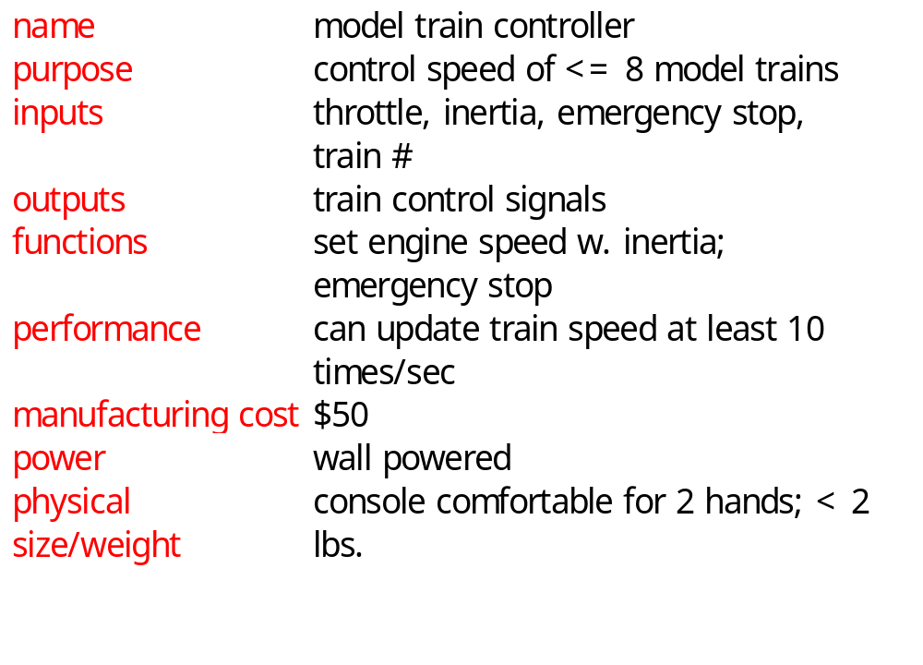
Requirements form

Slide 6
Conceptual specification
Before we create a detailed specification, we will make an initial, simplified specification.
  Gives us practice in specification and UML.
  Good idea in general to identify potential problems before investing too much effort in detail.

Slide 7
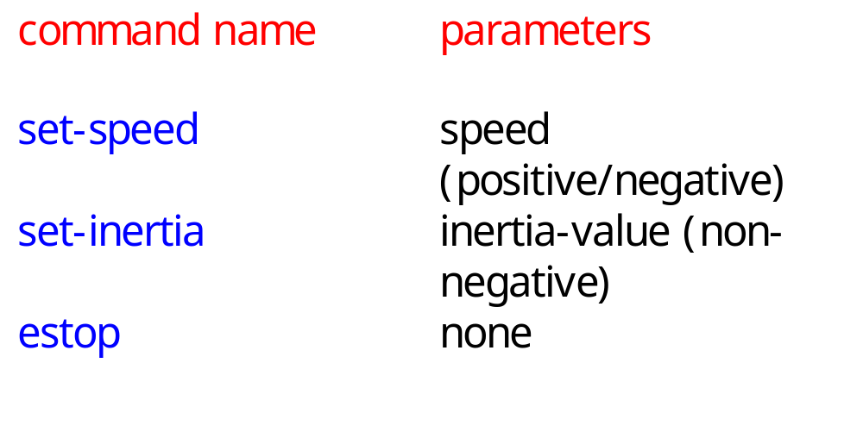
Basic system commands

Slide 8
Typical control sequence
:console
:train_rcvr
set-inertia
set-speed
set-speed
estop
set-speed

Slide 9
Message classes
command
set-speed
set-inertia
estop
value: integer
value: unsigned-
integer

Slide 10
Roles of message classes
Implemented message classes derived from message class.
  Attributes and operations will be filled in for detailed specification.
Implemented message classes specify message type by their class.
  May have to add type as parameter to data structure in implementation.

Slide 11
Subsystem collaboration diagram
Shows relationship between console and receiver (ignores role of track):
1..n: command
:console
:receiver

Slide 12
System structure modeling
Some classes define non-computer components.
  Denote by *name.
Choose important systems at this point to show basic relationships.

Slide 13
Major subsystem roles
Console:
  read state of front panel;
  format messages;
  transmit messages.
Train:
  receive message;
  interpret message;
  control the train.

Slide 14
Console system classes
console
1
1
1
1
1
1
panel
formatter
transmitter
1
1
1
1
receiver*
sender*

Slide 15
Console class roles
panel: describes analog knobs and interface hardware.
formatter: turns knob settings into bit streams.
transmitter: sends data on track.

Slide 16
Train system classes
train set
1
1..t
1
1
train
1
1
motor
interface
receiver
1
1
1
controller
1
1
1
detector*
pulser*

Slide 17
Train class roles
receiver: digitizes signal from track.
controller: interprets received commands and makes control decisions.
motor interface: generates signals required by motor.

Slide 18
Detailed specification
We can now fill in the details of the conceptual specification:
  more classes;
  behaviors.
Sketching out the spec first helps us understand the basic relationships in the system.

Slide 19
Train speed control
Motor controlled by pulse width modulation:
duty
cycle
+
V
-

Slide 20
Console physical object classes
knobs*
pulser*
train-knob: integer
speed-knob: integer
inertia-knob: unsigned-
integer
emergency-stop: boolean
pulse-width: unsigned-
integer
direction: boolean
sender*
detector*
send-bit()
read-bit() : integer

Slide 21
Panel and motor interface classes
panel
motor-interface
speed: integer
train-number() : integer
speed() : integer
inertia() : integer
estop() : boolean
new-settings()

Slide 22
Class descriptions
panel class defines the controls.
  new-settings() behavior reads the controls.
motor-interface class defines the motor speed held as state.

Slide 23
Transmitter and receiver classes
transmitter
receiver
current: command
new: boolean
send-speed(adrs: integer,
speed: integer)
send-inertia(adrs: integer,
val: integer)
set-estop(adrs: integer)
read-cmd()
new-cmd() : boolean
rcv-type(msg-type:
command)
rcv-speed(val: integer)
rcv-inertia(val:integer)

Slide 24
Class descriptions
transmitter class has one behavior for each type of message sent.
receiver function provides methods to:
  detect a new message;
  determine its type;
  read its parameters (estop has no parameters).

Slide 25
Formatter class
formatter
current-train: integer
current-speed[ntrains]: integer
current-inertia[ntrains]:
unsigned-integer
current-estop[ntrains]: boolean
send-command()
panel-active() : boolean
operate()

Slide 26
Formatter class description
Formatter class holds state for each train, setting for current train.
The operate() operation performs the basic formatting task.

Slide 27
Control input cases
Use a soft panel to show current panel settings for each train.
Changing train number:
  must change soft panel settings to reflect current train’s speed, etc.
Controlling throttle/inertia/estop:
  read panel, check for changes, perform command.

Slide 28
Control input sequence diagram
:knobs
:panel
:formatter
:transmitter
change in
control
settings
read panel
panel-active
change in speed/
inertia/estop
panel settings
send-command
read panel
send-speed,
send-inertia.
send-estop
panel settings
read panel
change in
train
number
change in
train number
panel settings
new-settings
set-knobs

Slide 29
Formatter operate behavior
update-panel()
panel-active()
new train number
idle
send-command()
other

Slide 30
Panel-active behavior
T
current-train = train-knob
update-screen
changed = true
panel*:read-train()
F
T
current-speed = throttle
changed = true
panel*:read-speed()
F
...
...

Slide 31
Controller class
controller
current-train: integer
current-speed[ntrains]: integer
current-direction[ntrains]: boolean
current-inertia[ntrains]:
unsigned-integer
operate()
issue-command()

Slide 32
Setting the speed
Don’t want to change speed instantaneously.
Controller should change speed gradually by sending several commands.

Slide 33
Sequence diagram for set-speed command
:receiver
:controller
:motor-interface
:pulser*
new-cmd
cmd-type
rcv-speed
set-speed
set-pulse
set-pulse
set-pulse
set-pulse
set-pulse

Slide 34
Controller operate behavior
wait for a
command
from receiver
receive-command()
issue-command()

Slide 35
Refined command classes
command
type: 3-bits
address: 3-bits
parity: 1-bit
set-speed
set-inertia
estop
type=010
value: 7-bits
type=001
value: 3-bits
type=000

Slide 36
Summary
Separate specification and programming.
  Small mistakes are easier to fix in the spec.
  Big mistakes in programming cost a lot of time.
You can’t completely separate specification and architecture.
  Make a few tasteful assumptions.

